Slide 1




Boys Lacrosse
Rules & Mechanics
Level II Training
January 2013

Slide 2
Key Organizations
US Lacrosse is the national governing body of the sport and primarily serves the youth game.
The National Federation of State High School Associations has led the development of education -based interscholastic sports and activities. The NFHS
publishes playing rules for Boys Lacrosse.
The Georgia High School Association is a voluntary organization that sets standards for the registration, training, and evaluation of officials in all competitive activities.
The Georgia Lacrosse Officials Association (GLOA) was founded in 2002 by a number of lacrosse enthusiasts in Atlanta in an effort to promote lacrosse officiating in North Georgia.

Slide 3
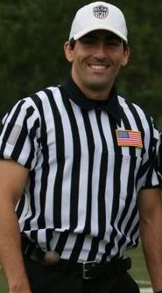
Gordon Corsetti
404-805-0926
gordoncorsetti@gmail.com

Slide 4
Level II Certification Plan
Classroom Training – 2 days (Westminster)
  1/06/2013 6:00pm – 9:00pm
  1/06/2013 – 1/20/2013 – Online Quizzes, Forum Posts, Discussion
  1/20/2013 6:00pm – 9:00pm
  1/20/2013 – 1/27/2012 – Online Testing
Field Training – 1 day (Westminster)
  1/27/2013 1:00pm-4:00pm
Scrimmage Observation
  Scheduled via Arbiter
US Lacrosse Level II Certification

Slide 5
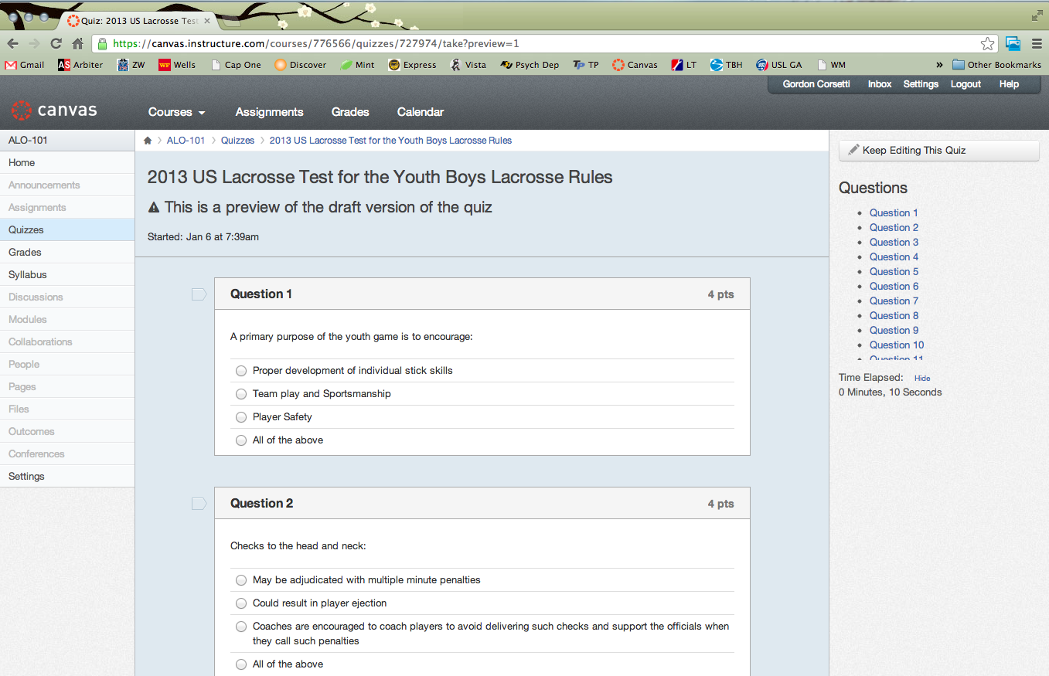

Slide 6
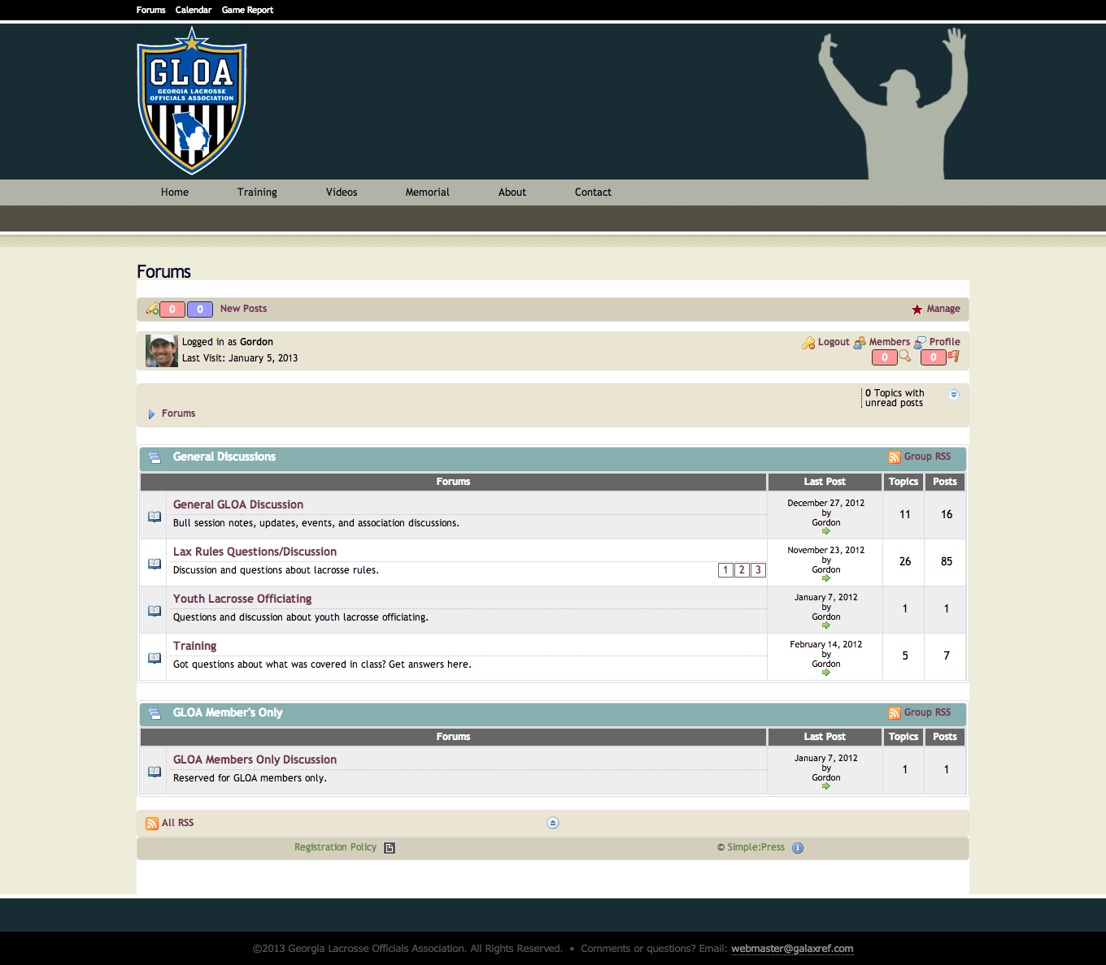

Slide 7
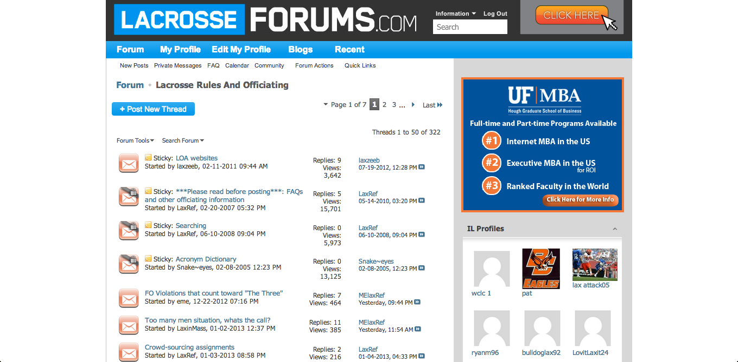

Slide 8
Green Font
If you see Green Font take note
  This font indicates resources for you during the season

Slide 9
Blue Font
If you see Blue Font:
  Lacrosse Officiating Wisdom
    Quotes
    Insights
    Experiences
    Technique

Slide 10
Bruce Weber – As They See ‘Em
“As an umpire you are neither inside the game, as the players are, nor outside it among the fans, but that the game passes through you, like rainwater through a filter, and that your job is to influence it for the better, to strain out the impurities, to make it cleaner, fairer, and more transparent without impeding it, corrupting it, changing its course, or making it taste funny.”

Slide 11
Red Font
If you see Red Font this indicates that:
  Something is important
  Something you may see on the test
  Something that will help you during the season

Slide 12
Day 1 Training Agenda
Introductions
Level II Training Goals
General Expectations
Points of Emphasis
Pre- Game Management
  Pre-Game – Prior, Morning, 45, 20, 5
  Lineup
  Game Level and Temperature
Game Mechanics
  Faceoff
  Settled Situations
  Stopping and Staring Play
  Out of Bounds
  Goal Scored
  Deep Restarts
  Penalty Enforcement
  Play On
  Equipment Checks
  Timeouts
  Fight Procedures
  Post Game
You Make The Call Discussion
    Videos 5-11

Slide 13
Introductions
Name
Years officiating
Why you got into officiating

Slide 14
Level II Training Goals
Enhance awareness of all training resources
Progress the knowledge and application of the rules, mechanics, and game management
Provide advanced mechanics, scenarios and tips that will improve performance
US Lacrosse Level II certification
Advance officials to the next level to serve as Referees in GLOA.

Slide 15
General Expectations
Conditioning – You must be in shape
Rules Knowledge – Continued review of all material
Mechanics – Know more than just the rules
Game Management – Flow of the game
Communication – Partner, coaches, players, table, site admin
Conduct – Sportsmanship and respect
Confidence – Preparation and experience, not arrogance
Focus – Concentration, block out distractions (COUNT!)
Consistency – Same threshold for both teams
Courage – Make the difficult calls
Uniform and Equipment – Impression of your ability

Slide 16
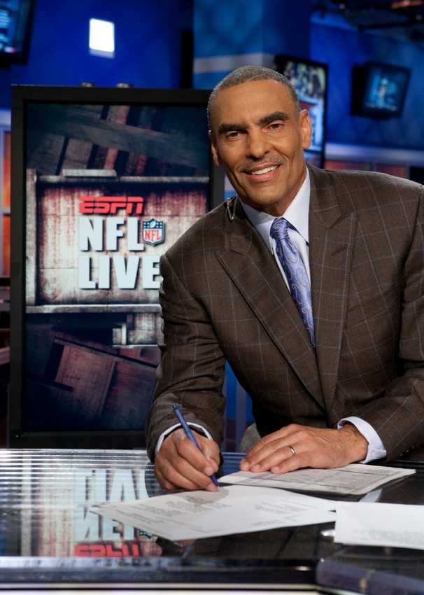
Other Expectations
Timeliness – Many people are relying on you
Respect – Show courtesy even in difficult situations
Composure – Keep your actions calm even in chaos
Controlled Emotions – Officiate without anger or fear
“Because you love this game, it is your obligation as a coach or official to be an ambassador to the game”
“The legacy of the game starts with the little ones who learn from you”

Slide 17
2013 Points of Emphasis
Hits to the Head/Neck
Field Dimensions
Properly Worn Equipment
Sideline Sportsmanship

Slide 18
Jim Evans – As They See ‘Em
“No father ever lit up a cigar, pointed to his new baby, and said, ‘That kid is going to be a major league umpire,’”

Slide 19
The Role of the “R”
In charge of the game with all game decisions regarding timing, scoring, and all rules administration
Responsible for both official’s actions
Communication with head coaches
Decision maker for game interruptions
Reporting on the game and any conduct issues
We Want Referees!

Slide 20
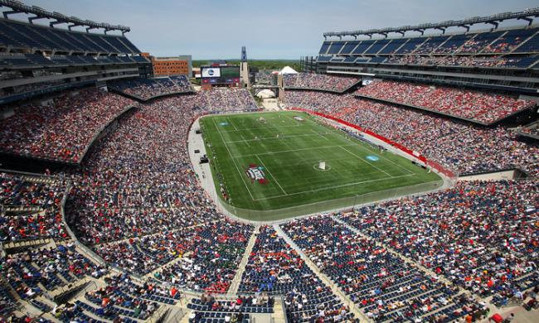
Every game is big for these kids
Give them your best every time!!

Slide 21
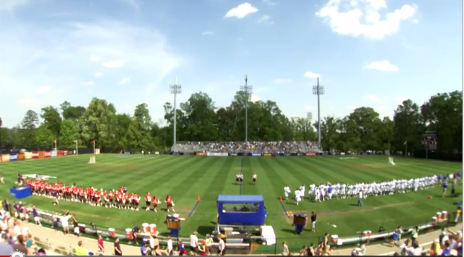
PRE-GAME MANAGEMENT

Slide 22
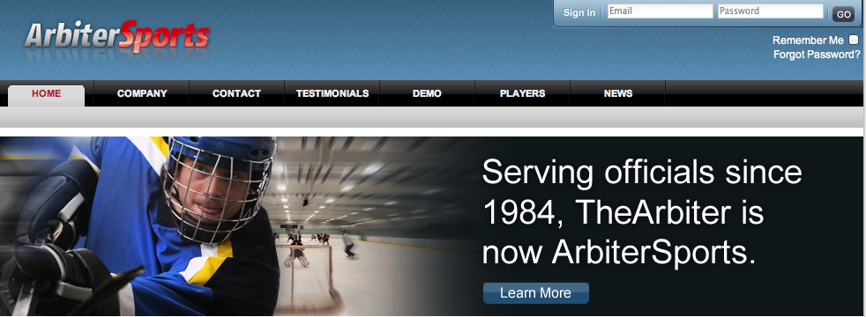
Prior to Game Day
Frequently utilize Arbiter to verify availability and game details
Remember names of coaches, officials, and game admins
Make contact no later than 48 hours prior. Umpire should check in with the Referee – phone 1st, email 2nd
Confirm level of game, uniform and pregame meeting time and location
Prepare coaches certification cards
Have a pregame discussion plan

Slide 23
Morning of a Game
Have a readily available contact list of all key game personnel from Arbiter
Plan for traffic and alternate routes
If there are any weather issues (snow, rain, etc.) the home team’s head coach or other representative should contact the Referee to confirm whether the game is still being played and any changes in time or location
Pack everything on your Uniform Checklist. Bring backups for everything

Slide 24
45 Minutes to Game Time
Meet your partner at the agreed time and location
Make final agreement on uniform. Officials must be dressed alike
Review rules for level of competition
Review Points of Emphasis (POE) and any new rules or memos from the league or assignor
Discuss coverage areas, stick checks, player counts on restarts, and anything else relevant to the game
If any situations have arisen during the season and where unsure how to handle that situation, talk about it.
This should be an interactive pre-game with both officials providing information, asking questions and listening.
GLOA Pregame Sheet

Slide 25
20 Minutes to Game Time
Should be on the field at least 20 minutes prior. Inspect the field.
Look for hazardous or dangerous issues on or near the field.
Check nets for holes and check field lines
Meet the home coach first. At this point only the Referee should be speaking
Introduce yourselves. Get the numbers of captains and in-home.
Perform coach’s certification and provide card. Ask if there are any pre-game or halftime activities or festivities. Confirm the face-off time
If there are any issues with the field, point them out to the Head Coach for him to address
Meet the visiting coach. Get his numbers and administer the Coaches Certification. Inform him of any pre-game or half time activates
You must spend the same amount of time with each coach. Perception is reality.
Depending on the level of competition, you may or may not have table personal. If you do have table personal the Referee should instruct them on what is required of them
While the Referee is talking with table personal, the Umpire should be available for equipment checks. He should do this on the far side of the field at the intersection of the midfield line and the wing line
Referee will join the Umpire when he is done with table personnel instructions
If there are still pre-game items that need to be discussed the officials can use this time to finish those discussions

Slide 26
5 Minutes to Game Time
Call for captains for coin toss. Do not use your whistle to achieve this
Officials introduce themselves to the captains and the captains to each other
Referee explains any special rules
Referee conducts the coin toss; visiting team calls it
Learn to be smooth with the coin flip procedures
Remember: This is not a time for a rules lecture or seminar. Keep it brief!
Remember: Have fun, it’s game time!!

Slide 27
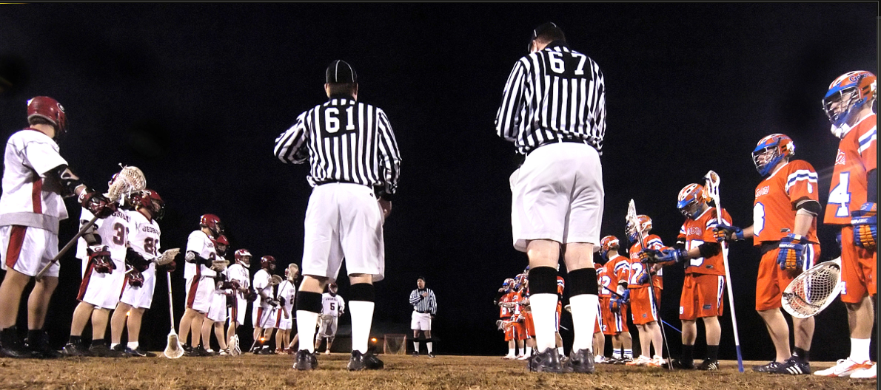
Lineup
Make sure balls are not in goals before the lineup starts
It is important for every game to have a well executed lineup. Sets the tone for the game
Pre-game speech should be short and focused on safety and sportsmanship
Know the name of your other official
Check for In Home

Slide 28
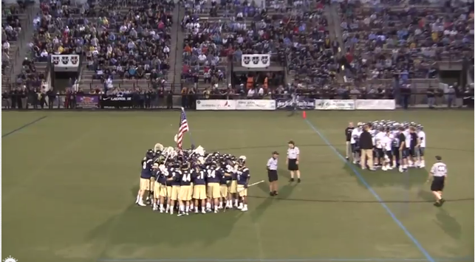
Game Level and Temperature
Factors to Consider:
Experience level of the officials
How close the game is likely to be
Importance of the game
Historical conduct of the coaches
Skill level of the teams
Whether the teams have a history
History with officials
Ties between the teams
Dynamics or personalities of the officials
Recognize the game temperature
Get control early !!

Slide 29
Mike Liner – It’s Not All Black and White
“We look around the stadium and realize we don’t have anyone on our side except those other men in striped shirts.”

Slide 30
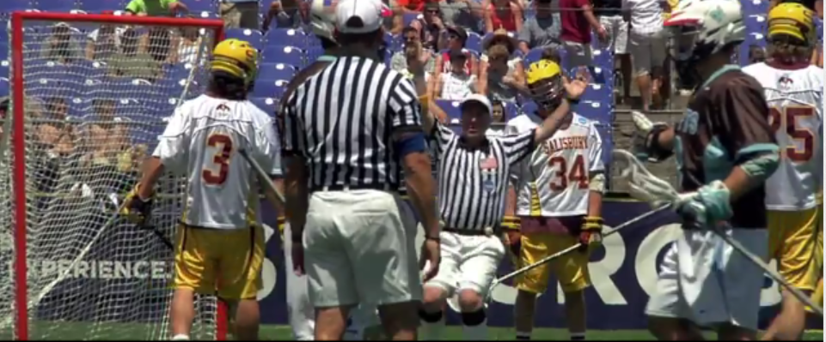
GAME MECHANICS

Slide 31
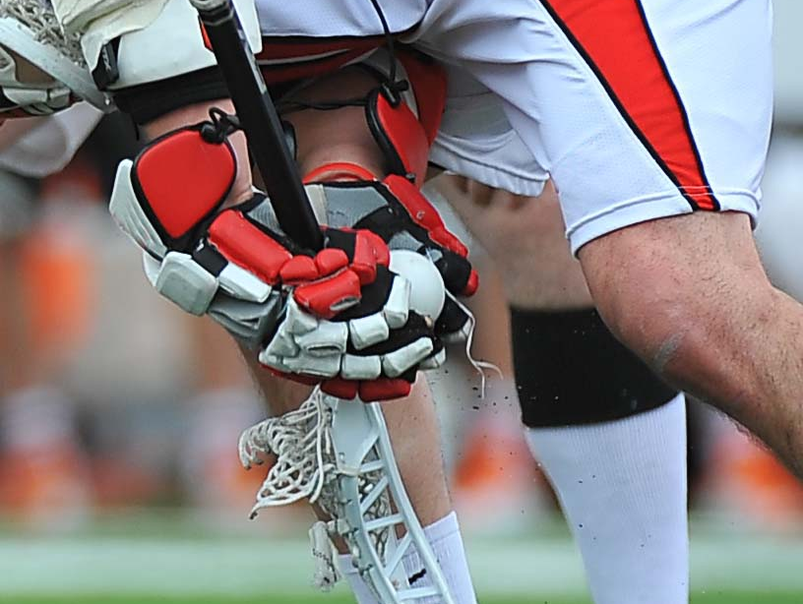
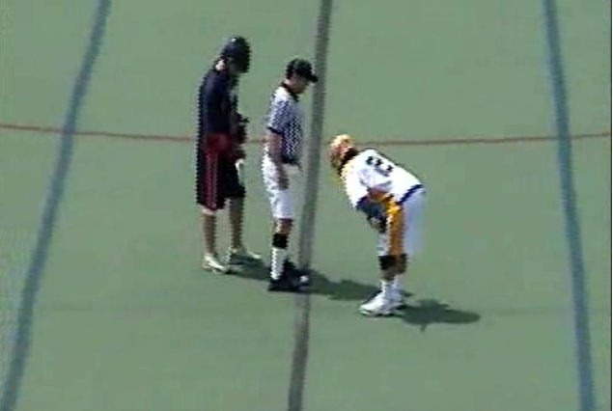
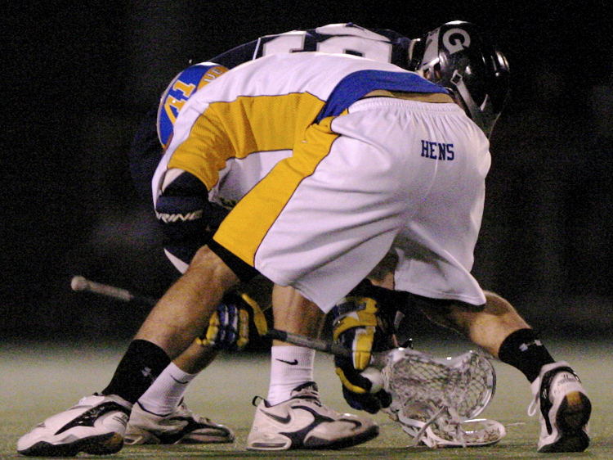
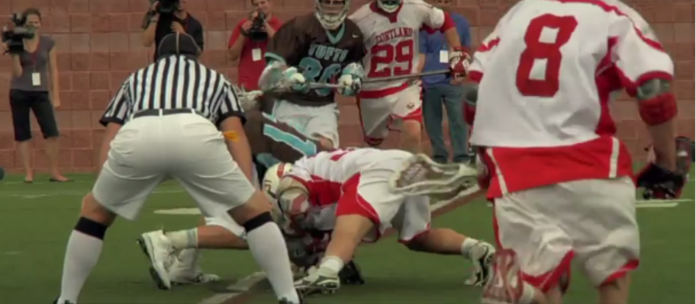
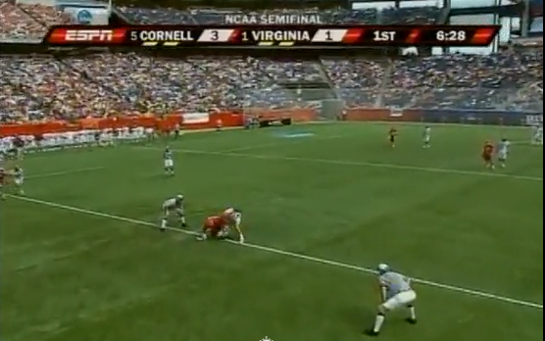
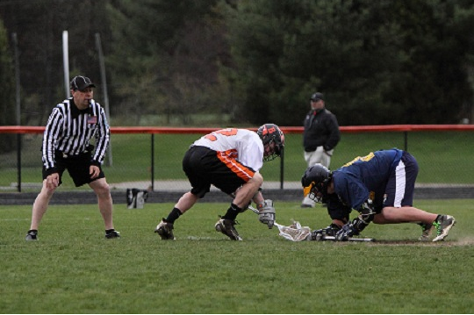
Faceoff
Stand over the ball until you are ready
Talk to the players just prior to the faceoff
Bring them down together - be emphatic!
Keep your head and eyes in the faceoff
Get to your position and do not move until the wing players have passed you or the ball is out.
Have the whistle in your mouth – down, set, whistle
Enforce everything you see – Make the Call!!
Violations – use illegal procedure hand signals and quick explanation of violation.
Notes:
Add the new rules

Slide 32
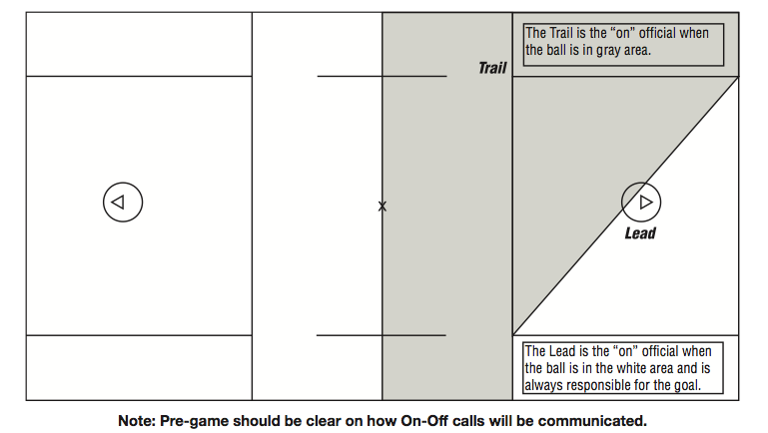
Settled Situations
Position and body language. Relaxed and focused
Lead:
  Primary responsibility is the goal
  Goal line extended as close as the play allows
Trail:
  No goal signal unless absolutely necessary
  Crease area for violations
  Late hits
  Don’t ball watch
Don’t assume the official closest to the ball sees all violations. You are a team!!

Slide 33
Don Balch – Vail LAREDO 3
“The ball has never committed a penalty!”

Slide 34
Stopping and Starting Play
Stopping:
  Try to avoid two whistles except on period endings
Starting:
  Communicate with signals and voice who has the incoming whistle
  Make eye contact before restarts to get the ready to go signal
  Restarts should be quick. Use authoritative commands to allow 5 yards.
Use the 5 second count and delay of game to keep the game moving
Always check the readiness of the goalie before starting play – 5 seconds

Slide 35
Out of Bounds
Use slow definitive directional signals. Thumbs tucked
Don’t oversell routine calls
Use animated signals for highly contested or key play out of bounds calls
Use eye contact and proper signals to communicate sideline and end line out of bounds
Avoid the “I don’t know” signal or the flip flop. Use AP if needed
Come together and get the call right if there is any confusion.
Don’t make multiple mistakes or compound errors

Slide 36
Sean Murphy – Vail LAREDO 3
“It is better to be slow and right than fast and wrong!”

Slide 37
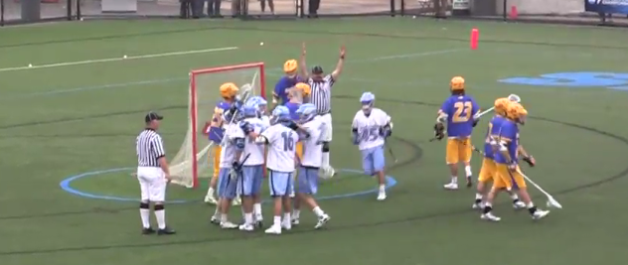
Goal Scored
Take the extra second to make sure the ball is in the goal and not in the net
Blow the whistle and run towards the goal, making eye contact with your partner
If no goal, make signal big and animated
Give the goal signal standing at the edge of the pipe
Talk to the goalie with instructions that you will get the ball. This avoids the goalie tossing it to midfield
Keep eye contact on the players. Expect residual action
Use low voice preventative warnings

Slide 38
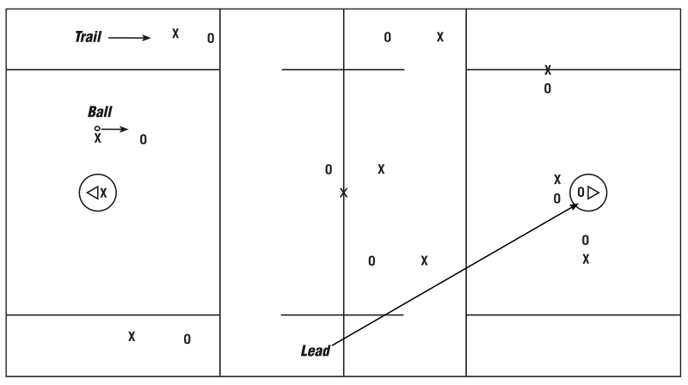
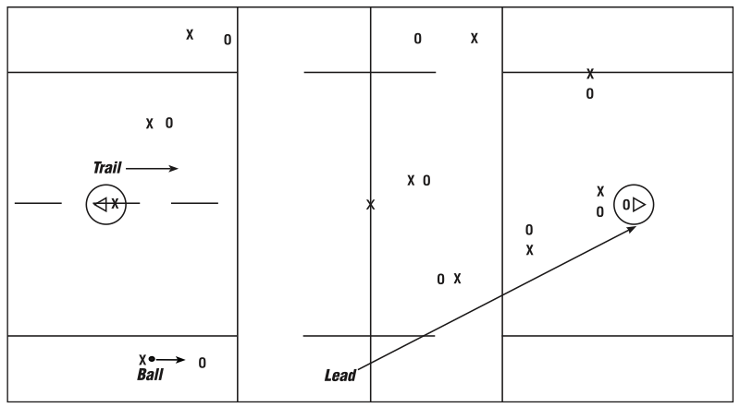
Deep Restarts
Trail
  Restart
  Move with the ball
  Offsides
  Substitutions
Lead
  Primary for goal
  Hold center line for offsides
Counting forward is key
Be a half field ahead of the ball

Slide 39
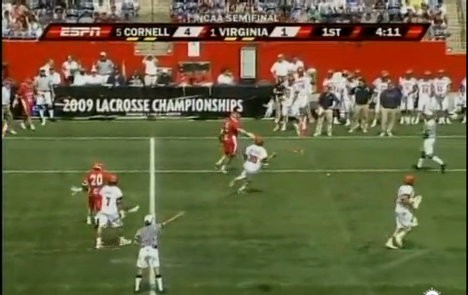

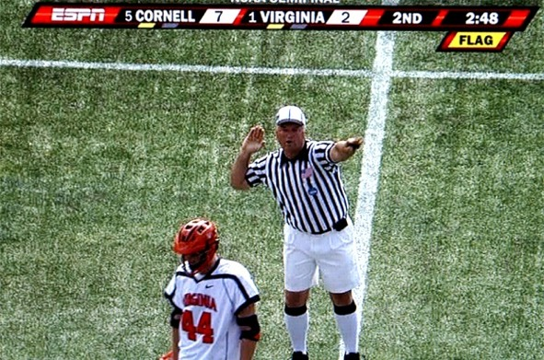

Penalty Enforcement
Get stationary with an unobstructed view in front of the box
Be slow and calm
CNOTE – Color, number, foul, time
Clear with hand signals and numbers

Slide 40


Slide 41
Play On
Use the play on to improve the flow of the game only if the offended team has a clear opportunity to play the ball without a disadvantage
Be cautious with play on calls in heavily contested loose balls.
Use loose ball crease violation play on calls only when the goalie or defender has a clear play on the ball. Quick score can make an awkward call

Slide 42
Equipment Checks
Gather sticks and meet near midfield away from the benches
R should measure with back to the bench. Close to the chest
U should watch the benches
4 dead ball checks per game. Check all equipment
  Team timeout, after goal, before faceoff, between periods
Make stick checks fast and efficient
Violations should be administered with a flag down in front of the scorer’s table

Slide 43
Timeouts
Only head coach or player on the field – dead ball or in possession
Anticipate timeouts based on game situations and always give the benefit of the doubt to the coach
Move to where they players are crossing and restrict the bench players and coaches to 10 yards from the sideline
Inform the coach where the ball will be coming in
When benches have settled, start the 2 minute timer and write the time on your card
Give full 1:40 unless team that called the time out is ready prior
Blow the whistle with 20 seconds remaining
Do not write on your card until the play has settled. Keep eye contact on the players.

Slide 44
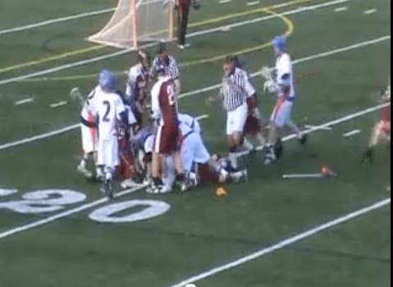
Fight Procedures
Nearest Official:
  Flag in the air
  Verbal commands and whistles to attempt to break up the fight
  Strong verbal warnings to other players
  Observe all numbers involved and sequence
Farthest Official:
  Move to a position in front of the benches
  Freeze the benches
  Record the numbers of all players and coaches leaving the bench area
After the incident
  Players to the bench area
  Meet and discuss fouls and sequence
  Report violations to the bench
  Take your time, clearly communicate expectations
After the game
  Written report in GALAXREF.COM/contact/game-report and call assignor
Stay calm
Use judgment to avoid physical contact while dealing with the fight
Limit remarks to facts in the report

Slide 45
Post Game
A 5-10 minute conversation after the game can be an invaluable learning tool
Should include the game officials Assignors, Observers, Mentors, fellow officials
Should not include: players, coaches, fans, or media
Should occur away from the field or public view
Conversations may include game situations, rules applications, game management issues
Key discussions on observable behavior
Why a post game:
  We learn more from our mistakes
  With a game fresh in our mind it is easier to recall details and specifics of a given play to discuss
  A chance to work through a play and what an official might or might not have done differently
  Get feedback from a more experienced official
This is a learning opportunity, not a time to berate a fellow official
Candor is important
Be an active listener

